Slide 1
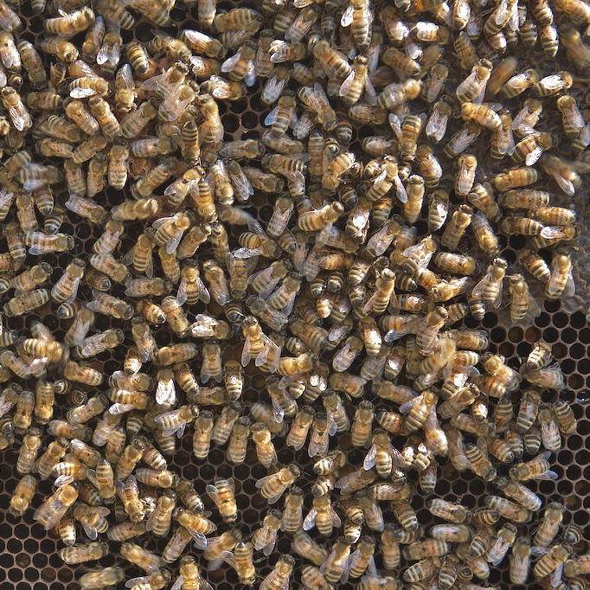
C♯ JSON and the REST
Rasmus Lystrøm
Associate Professor
ITU
This Photo by Unknown Author is licensed under CC BY-SA-NC

Slide 2

Agenda
XML
SOAP
JSON
YAML
REST
ASP.NET Core
Web API with ASP.NET Core
gRPC
GraphQL
This Photo by Unknown Author is licensed under CC BY-NC-ND

Slide 3
XML

Slide 4
XML
eXtensible Markup Language
Markup language like HTML
Designed to carry data, not to display data
Tags are not predefined – You must define your own tags
Designed to be self-descriptive

Slide 5
XML does not do anything
XML was created to structure, store, and transport information
<?xml version="1.0" encoding="UTF-8"?>
<note id="1">
<to>Kathleen B.</to>
<from>Tom W.</from>
<subject>Reminder</subject>
<body>Don't forget small change!</body>
</note>

Slide 6
How Can XML be Used?
Separates data from HTML
Simplifies data sharing
Simplifies data transport
Simplifies platform changes
Used to create new (Internet) languages
XHTML
WSDL for describing web services
RSS and ATOM for news feeds
XAML

Slide 7
SOAP

Slide 8
SOAP

Slide 9
SOAP request
POST https://store.com/services/PriceService/getPrice
<?xml version="1.0"?> <soap:Envelope xmlns:soap="http://www.w3.org/2003/05/soap-envelope/" soap:encodingStyle="http://www.w3.org/2003/05/soap-encoding"> <soap:Body> <m:GetPrice xmlns:m="https://www.w3schools.com/prices"> <m:Item>Apples</m:Item> </m:GetPrice> </soap:Body> </soap:Envelope>
Source: https://www.w3schools.com/xml/xml_soap.asp

Slide 10
SOAP response
<?xml version="1.0"?> <soap:Envelope xmlns:soap="http://www.w3.org/2003/05/soap-envelope/" soap:encodingStyle="http://www.w3.org/2003/05/soap-encoding"> <soap:Body> <m:GetPriceResponse xmlns:m="https://www.w3schools.com/prices"> <m:Price>1.90</m:Price> </m:GetPriceResponse> </soap:Body> </soap:Envelope>
Source: https://www.w3schools.com/xml/xml_soap.asp

Slide 11
JSON

Slide 12
JSON
JavaScript Object Notation
Lightweight text-data interchange format
Language independent (uses JavaScript syntax)
"Self-describing" and easy to understand

Slide 13
JSON Syntax
(subset of the JavaScript object notation syntax)
Data is in name/value pairs
Data is separated by commas
Curly braces hold objects
Square brackets hold arrays

Slide 14
JSON Name/Value Pairs
A name/value pair consists of a field name (in double quotes), followed by a colon, followed by a value:
"firstName": "John"
This is simple to understand, and equals to the JavaScript statement:
firstName = "John"

Slide 15
JSON Data Types
Number (integer or floating point)
String (in double quotes)
Boolean (true or false)
Array (in square brackets)
Object (in curly brackets)
null

Slide 16
Examples
{ "alterEgo": "Batman", "firstAppearance": 1939 }
[
{ "firstName": "John", "lastName": "Doe" },
{ "firstName": "Jane", "lastName": "Doe" },
{ "firstName": "John", "lastName": "Smith" }
]
null
"John Doe"

Slide 17
Best of both worlds?
https://www.ibm.com/support/knowledgecenter/en/SS9H2Y_7.7.0/com.ibm.dp.doc/json_jsonxconversionexample.html

Slide 18
YAML

Slide 19
YAML
YAML Ain't Markup Language
Human-readable data-serialization language.
It is commonly used for configuration files and in applications where data is being stored or transmitted.
Superset of JSON

Slide 20
Examples
people:
- first_name: John
last_name: Doe
- first_name: Jane
last_name: Doe
- first_name: John
last_name: Smith

Slide 21
REST
http://
REpresentational State Transfer

Slide 22
HTTP request
URI: string
(Query): key/value pairs
Method: string
Header: key/value pairs
Body: string/binary

Slide 23
HTTP response
Status-Code: number
Header: key/value pairs
Body: string/binary

Slide 24
REST
Maps your CRUD actions to HTTP verbs
Action | Verb
Create | POST
Read (Retrieve) | GET
Update (Replace) | PUT
Update (Modify) | PATCH
Delete | DELETE

Slide 25
HTTP status codes
Code | Meaning
200 | OK
201 | Created
202 | Accepted
204 | No Content
301 | Moved Permanently
302 | Found (Previously "Moved temporarily")
307 | Temporary Redirect
308 | Permanent Redirect
Code | Meaning
400 | Bad Request
401 | Unauthorized
403 | Forbidden
404 | Not Found
409 | Conflict
415 | Unsupported Media Type
418 | I’m a Teapot
422 | Unprocessable Entity
500 | Internal Server Error
501 | Not Implemented
503 | Service Unavailable

Slide 26
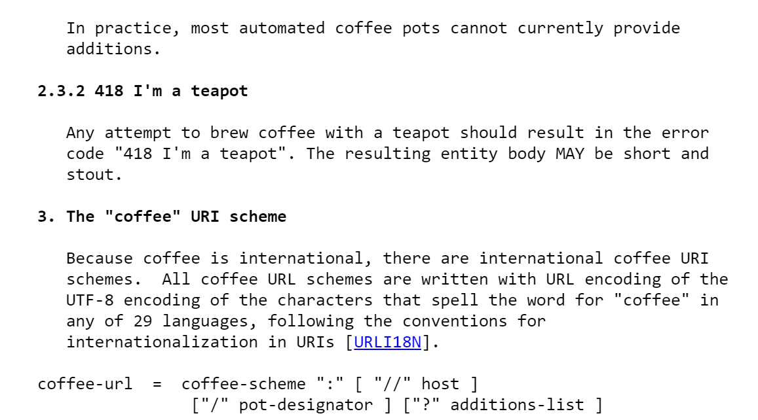
RFC2324: Hyper Text Coffee Pot Control Protocol
Source: https://tools.ietf.org/html/rfc2324

Slide 27
HTTP headers
Header Field | Description | Examples
Accept | Content-Types that are acceptable for the response | text/plain application/json application/xml
Content-Type | The media type of the body of the request (POST, PUT, and PATCH) | application/x-www-form-urlencoded application/json; charset=utf-8
Authorization | Authentication credentials for HTTP authentication | Bearer ey…

Slide 28
Why REST?
Simple, both conceptually and programmatically
Simpler and cleaner than SOAP
REST is the new black

Slide 29
REST request
GET https://store.com/prices/Apples

Slide 30
REST response
1.9

Slide 31
HTTP request
URI: https://futurama.com/api/characters
Method: POST
Header:
Content-Type: application/json; charset=utf-8
Authorization: Bearer ey...
Body:
{
"name": "Bender",
"species": "Robot",
"planet": "Earth"
}

Slide 32
HTTP response
Status-Code: 201
Header:
Content-Type: application/json; charset=utf-8
Location: https://futurama.com/api/characters/42
Body:
{
"id": 42,
"name": "Bender",
"species": "Robot",
"planet": "Earth"
}

Slide 33
ASP.NET Core

Slide 34
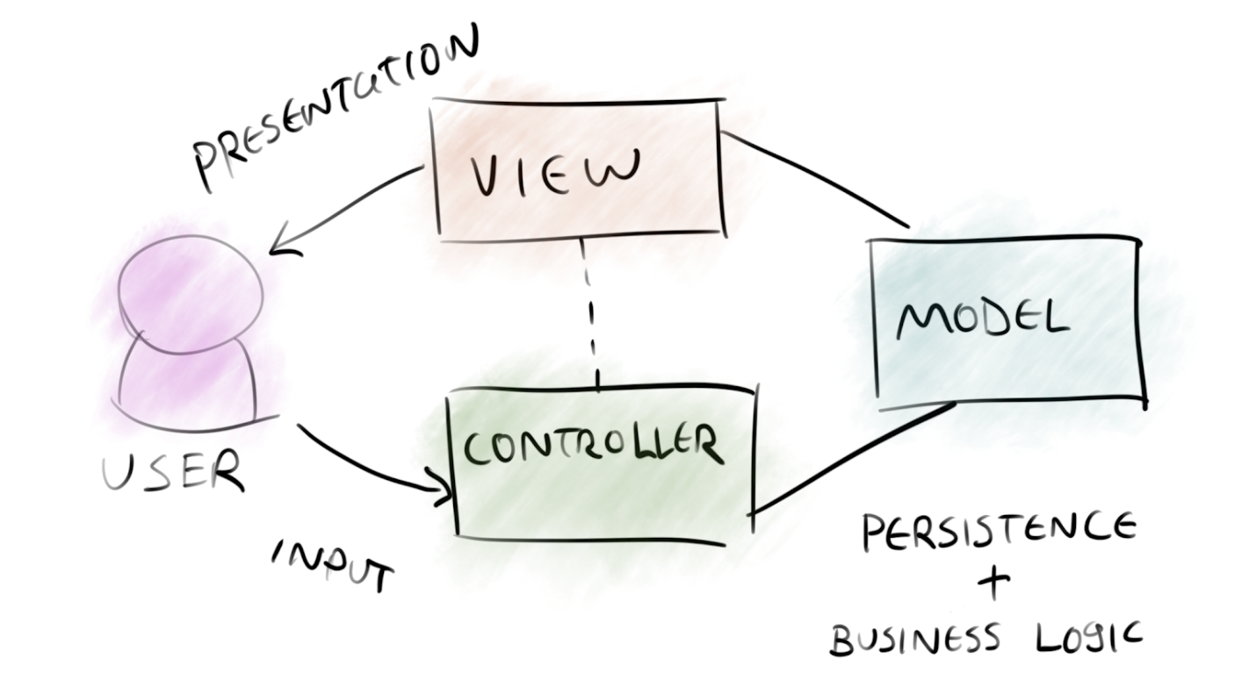
Model – View – Controller

Slide 35
ASP.NET Web API
Application

Slide 36
ASP.NET Core Web API
Demo

Slide 37
Controller
Class
Derive from ControllerBase
Decorate with [ApiController] and [Route("[controller]")]
Method
Decorate with [HttpGet], [HttpPost], [HttpPut], [HttpDelete]
Return specific type, IActionResult, or ActionResult<T> - or async Task<...>.

Slide 38
ASP.NET (Web API) best practices

Slide 39
Be RESTful
Use proper status codes
Use meaningful routes
Use proper HTTP methods
Don’t throw exceptions

Slide 40
Use user secrets in development
dotnet user-secrets init
dotnet user-secrets set "ConnectionStrings:<connectionstring-name>" "<connnection-string>"

Slide 41
Use built-in IoC container
services.AddDbContext<MyContext>(o => o.UseSqlServer(Configuration.GetConnectionString("MyConnectionStringName")) );
services.AddScoped<IMyContext, MyContext>();
services.AddScoped<IMyRepository, MyRepository>();

Slide 42
Consider running migrations on load
using (var serviceScope = app.ApplicationServices .GetRequiredService<IServiceScopeFactory>().CreateScope())
{
var context = serviceScope.ServiceProvider.GetService<SuperheroContext>();
context.Database.Migrate();
}

Slide 43
Support the OpenAPI Specification (Swagger)
dotnet add package Swashbuckle.AspNetCore
using Microsoft.OpenApi.Models;
services.AddSwaggerGen(c =>
{
c.SwaggerDoc("v1", new OpenApiInfo { Title = "My API", Version = "v1" });
});
app.UseSwagger();
app.UseSwaggerUI(c =>
{
c.SwaggerEndpoint("/swagger/v1/swagger.json", "My API V1");
c.RoutePrefix = string.Empty;
});

Slide 44
Support HTTPS only
dotnet dev-certs https --trust
app.UseHttpsRedirection();

Slide 45
Standardize on lowercase urls
services.AddRouting(options => options.LowercaseUrls = true);

Slide 46
Secure your Web API
Azure AD (later)
Azure AD B2C
Other 3rd party
Do not write your own security layer!!!

Slide 47
gRPC

Slide 48
gRPC Remote Procedure Calls
gRPC is a modern, open source, high-performance remote procedure call (RPC) framework that can run anywhere. gRPC enables client and server applications to communicate transparently, and simplifies the building of connected systems.
$ dotnet new grpc
Source: https://github.com/grpc/grpc

